Slide 1
Graph Neural Networks
What they are, how to build them, and their applications
Isaiah J. King

Slide 2
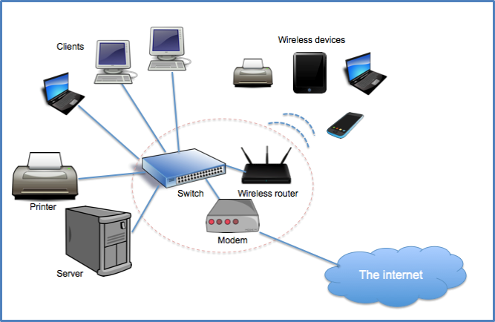
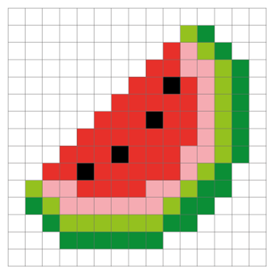
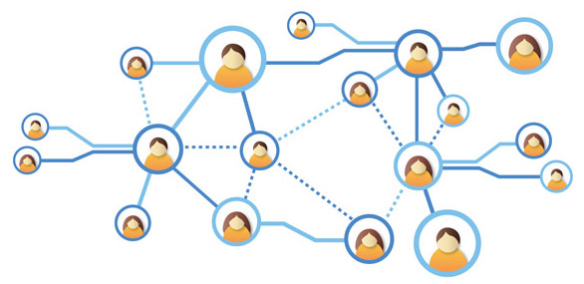
(Almost) Everything is a Graph
Social Networks Computer Networks Images
Img src (left to right) https://blog.soton.ac.uk/skillted/2015/04/05/graph-theory-for-skillted/
https://www.schoolsofkingedwardvi.co.uk/ks2-computing-computing-theory-5-computer-networks/
https://projects.raspberrypi.org/en/projects/pixel-art-unplugged/1

Slide 3
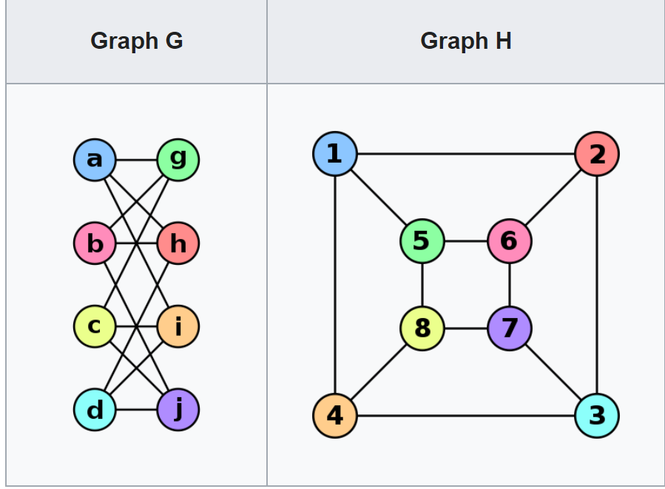
Graph Equality (aka isomorphisms)
1
2
1
2
3
?
Graph G=H iff
For all edges (u,v) in G
There exists (f(u), f(v)) in H
Very hard (NP-hard?) to find solutions
3
4
4
5
6
5
6
Img src: https://en.wikipedia.org/wiki/Graph_isomorphism

Slide 4
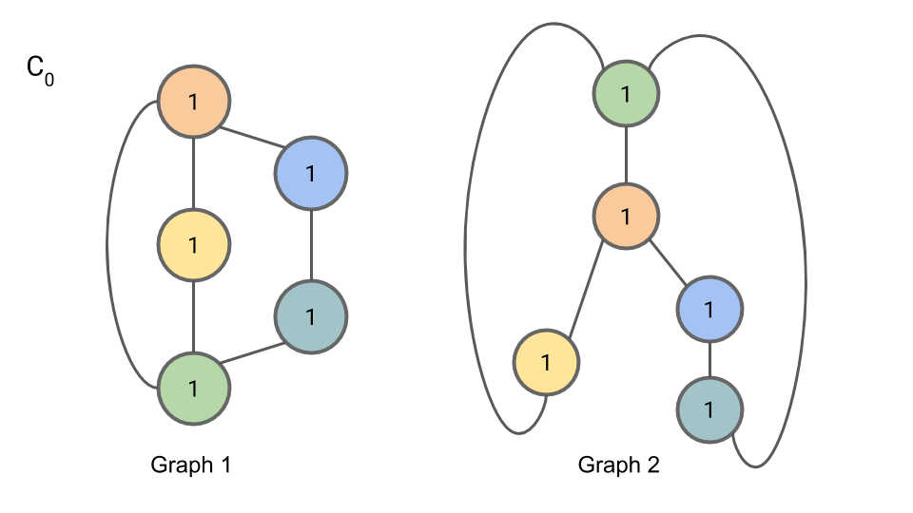
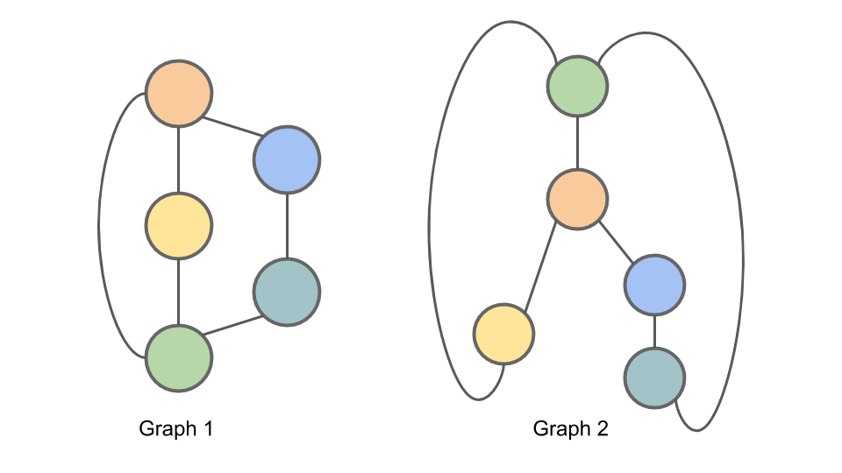
Graph Inequality
Weisfeiler-Lehman Isomorphism Test
Images for all WL slides: https://davidbieber.com/post/2019-05-10-weisfeiler-lehman-isomorphism-test/

Slide 5
WL-Isomorphism Test (cont’d)

Slide 6
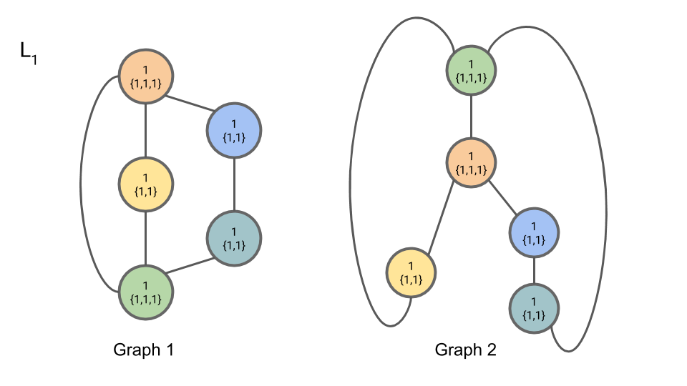
WL-Isomorphism Test (cont’d)
1
1
1
1
1

Slide 7

WL-Isomorphism Test (cont’d)

Slide 8



WL-Isomorphism Test (cont’d)

Slide 9

WL-Isomorphism Test (cont’d)
Graph | 9 | 8 | 7
1 | 2 | 1 | 2
2 | 2 | 1 | 2

Slide 10
WL-Isomorphism Exercise
?

Slide 11
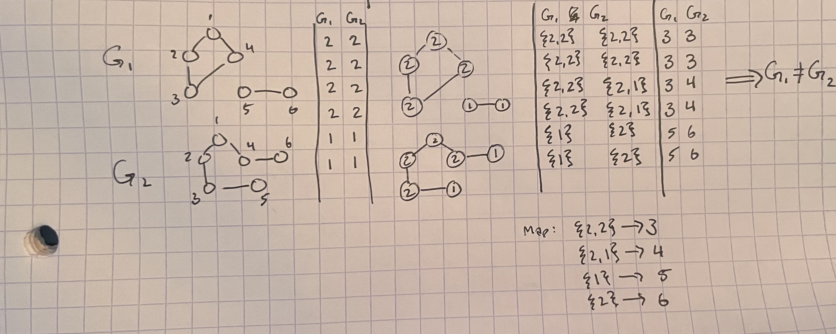
Solution

Slide 12
Wait, what does this have to do with GNNs?
Graph summarization
Condensing the information of a graph into a single vector
Comparing graph vectors tells us something about the two graphs
Node representation
Iteration 1: how many edges each node has
Iteration 2: how many edges each node’s neighbor has
Message passing
Important mechanism for GNNs

Slide 13
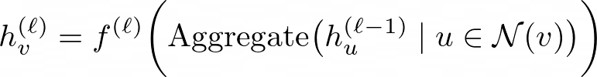
Message Passing Neural Networks
General term for family of GNNs
Extends WL test
Pass vectors instead of numbers (also called WL-n test)
Aggregate and nonlinear transform instead of hashing
Allows for nodes to have input features

Slide 14
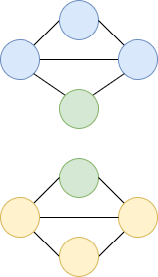
Example
Aggregate(.) = Mean; f(x) = sigmoid(x)
Trek | LOTR
1.0 | -0.5
0.5 | 0.5
0.5 | 0.5
-0.5 | 1.0

Slide 15
Example
Aggregate(.) = Mean; f(x) = sigmoid(x)
Trek | LOTR
1.0 | -0.5
0.5 | 0.5
0.5 | 0.5
-0.5 | 1.0
Trek | LOTR
5/6 | -1/6
7/8 | -1/4
-1/4 | 7/8
-1/6 | 5/6
Aggregate

Slide 16
Example
Aggregate(.) = Mean; f(x) = sigmoid(x)
Trek | LOTR
1.0 | -0.5
1.0 | 0.5
0.5 | 1.0
-0.5 | 1.0
Trek | LOTR
5/6 | -1/6
7/8 | -1/4
-1/4 | 7/8
-1/6 | 5/6
Trek | LOTR
0.70 | 0.46
0.71 | 0.43
0.43 | 0.71
0.46 | 0.70
Aggregate
sigmoid

Slide 17
Example
0.8
Trek | LOTR
0.70 | 0.46
0.71 | 0.43
0.43 | 0.71
0.46 | 0.70
0.4
0.4
0.8

Slide 18
Some popular GNNs

Slide 19
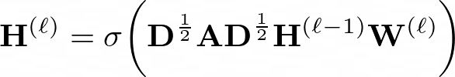
Graph Convolutional Networks (GCN)
One of the earliest MPNNs, still the go-to
D^½ A D^½ is the norm. adjacency matrix (calculated once)
By multiplying features by adj. mat., we’re efficiently doing mean message passing
Finally, multiply aggregated result by trainable param W and sigmoid result
Very similar to image Conv. Mathematically same as the convolution operator if node feats treated as signals

Slide 20
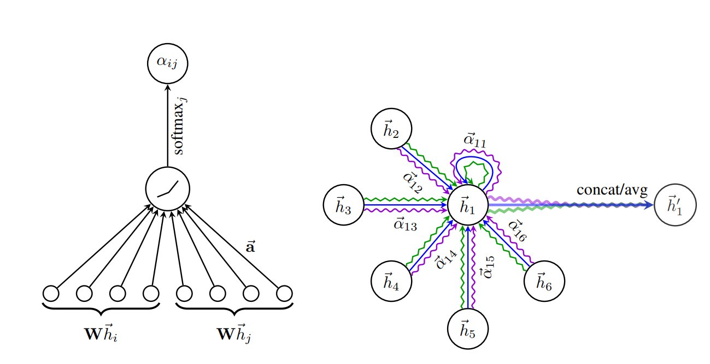
Graph Attention Networks (GAT)
During the aggregation phase multiply node signals by trainable param a
Essentially does a weighted average instead of mean
Train more than one a parameter to get “multihead attention”

Slide 21
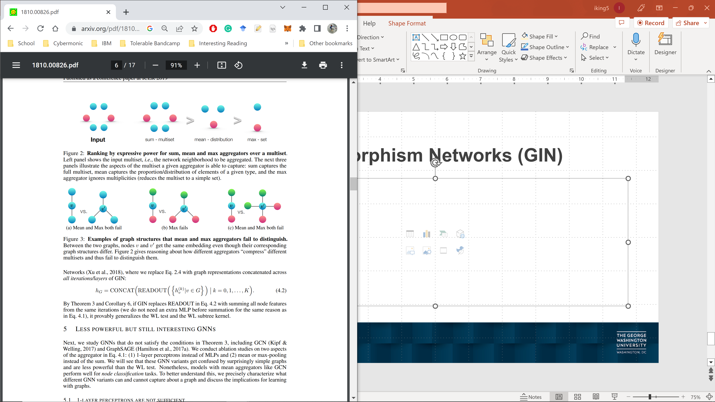
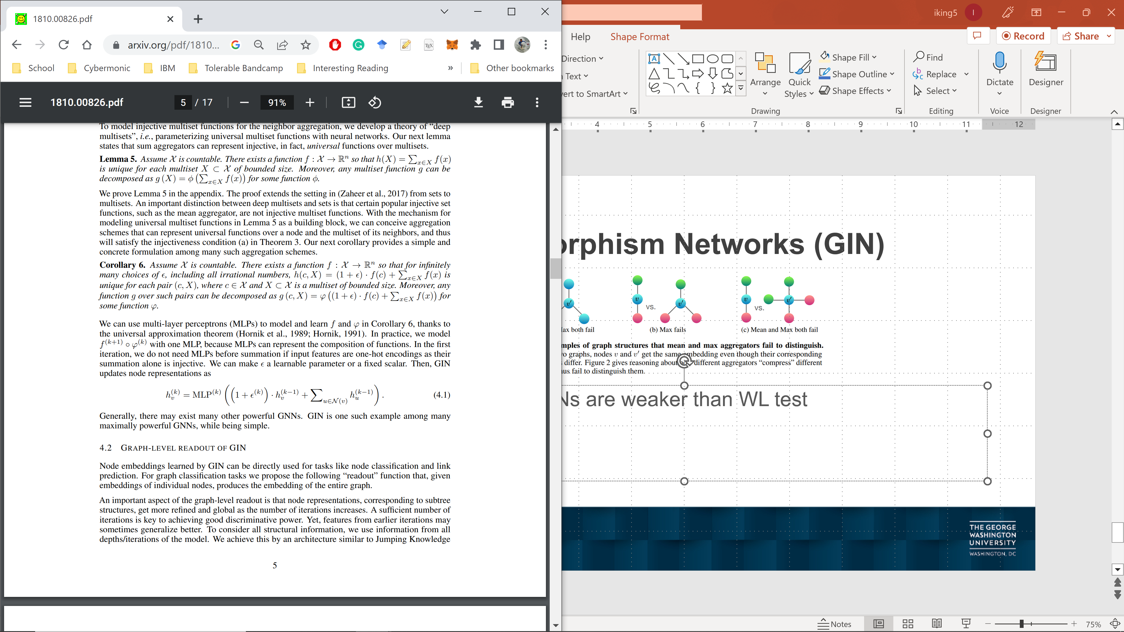
Graph Isomorphism Networks (GIN)
Show that MPNNs are weaker than WL test
Prove that using MLP (standard neural net) as aggregator creates maximally expressive GNN

Slide 22
Uses of GNNs
Graph classification
Medical: Drug discovery, protein folding (molecules as graphs)
Images: Pixels as nodes with neighbors as adjacent pixels
NLP: nodes are words, edges are adjacent ones
Node classification
Images: Finding pixels that make up certain objects
Databases: genre of movie given shared actors/paper given shared authors, etc.
Link prediction
Cyber security: which computers shouldn’t be talking to each other?
Knowledge Graphs: inference, which edges should exist?

Slide 23
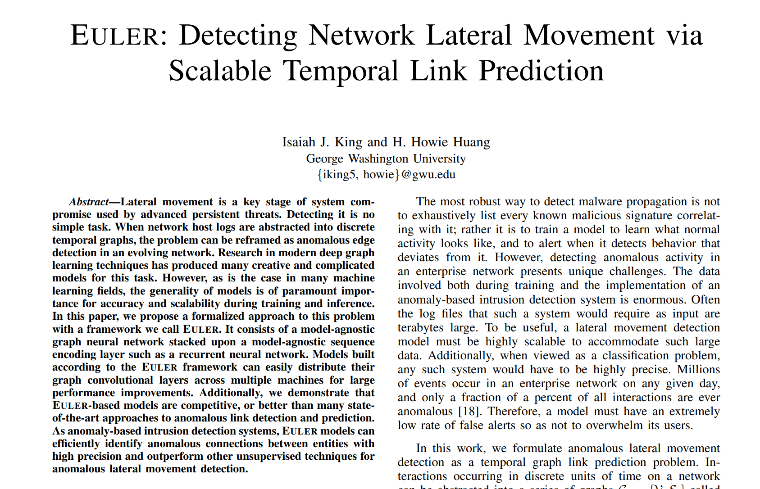
Case study 1: Link prediction for cyber security

Slide 24
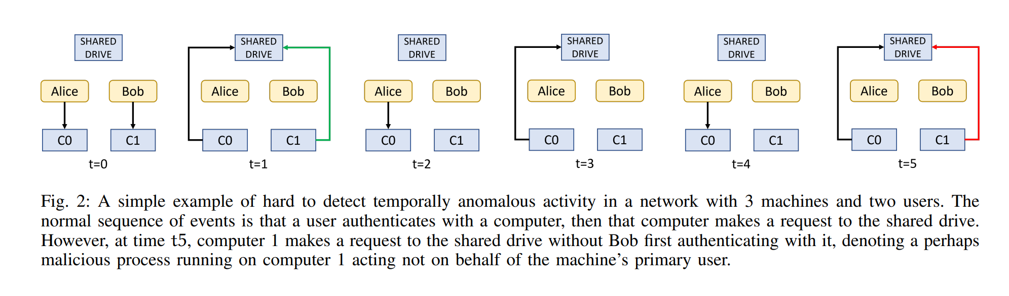
Network activity as a temporal graph

Slide 25
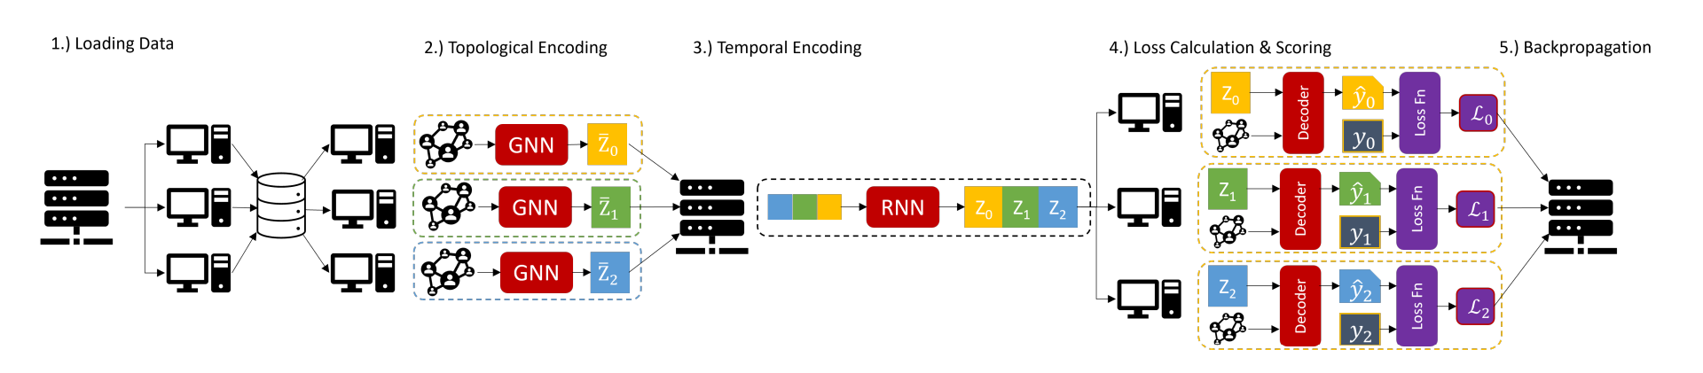
Solution: distributed temporal link predictor

Slide 26
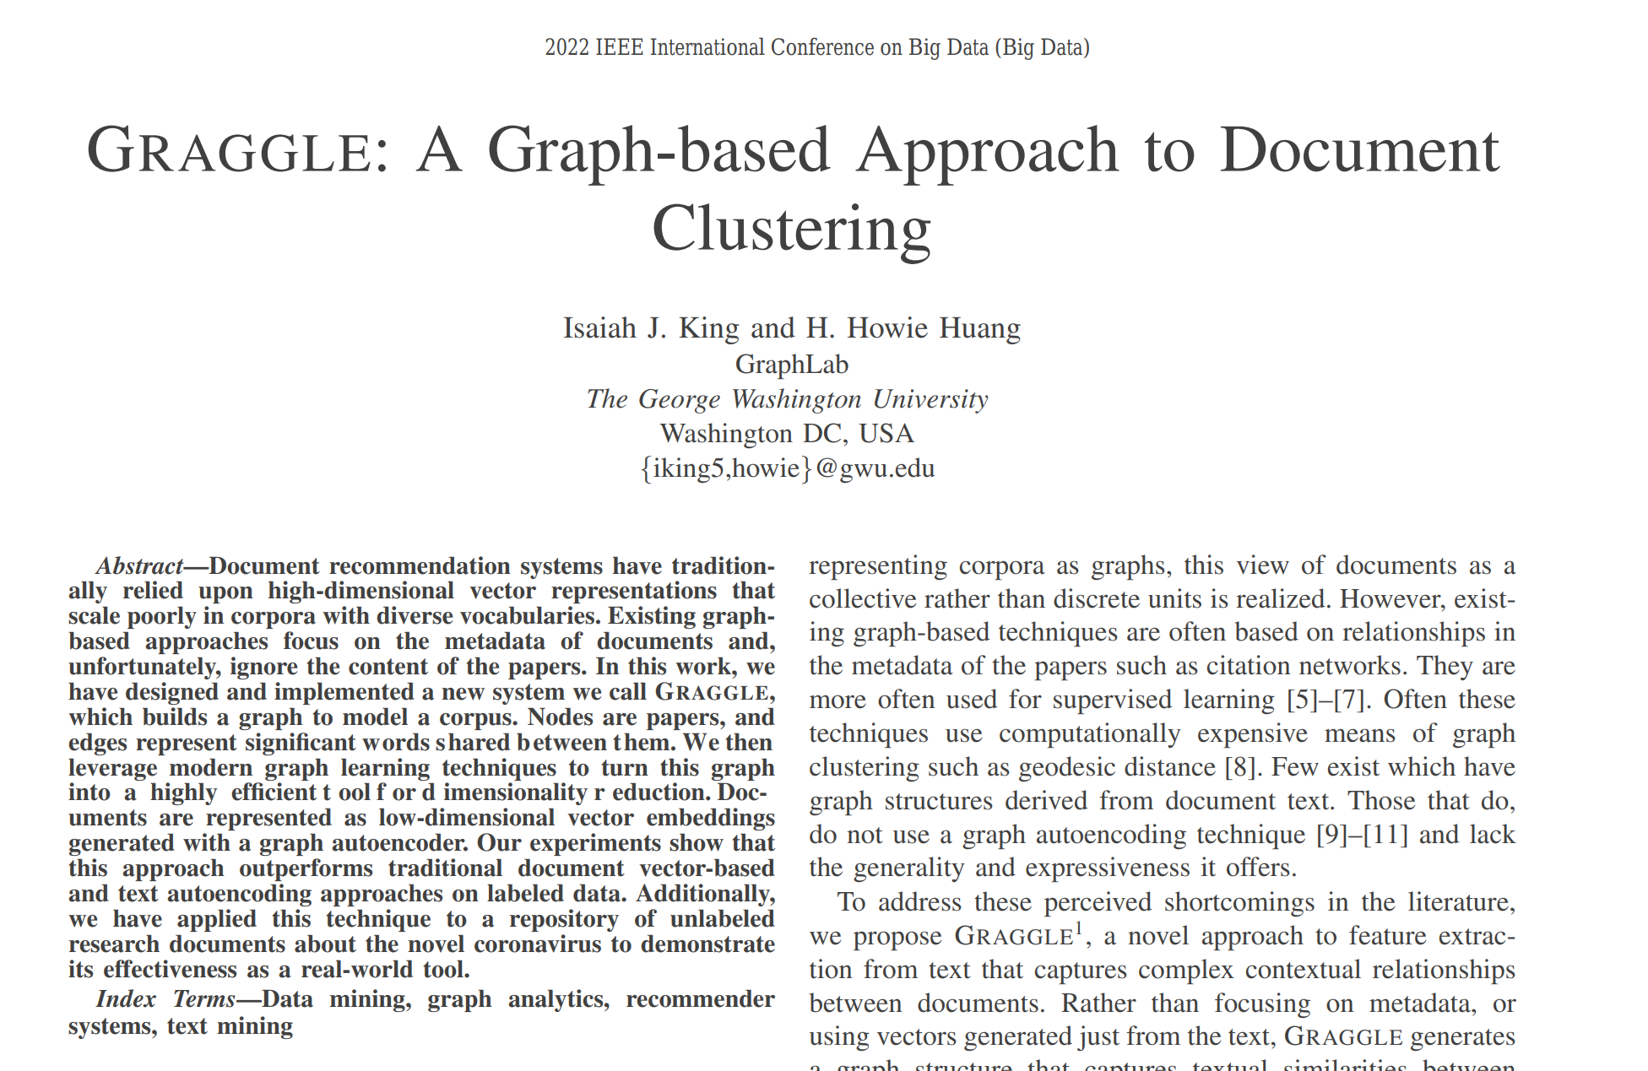
Case study 2: Node embedding for document recommendation

Slide 27
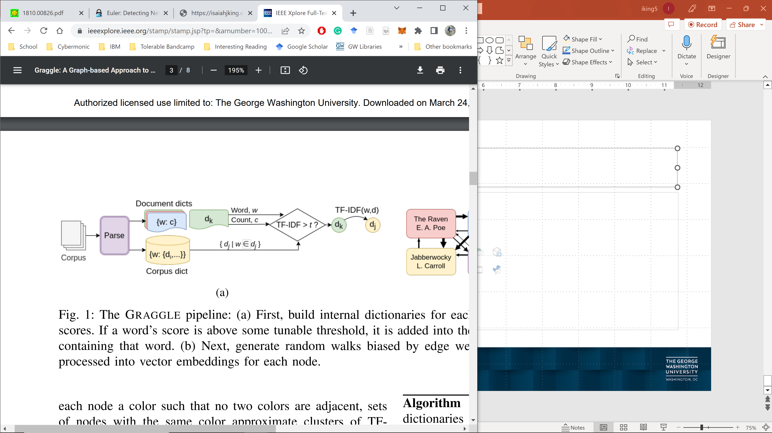
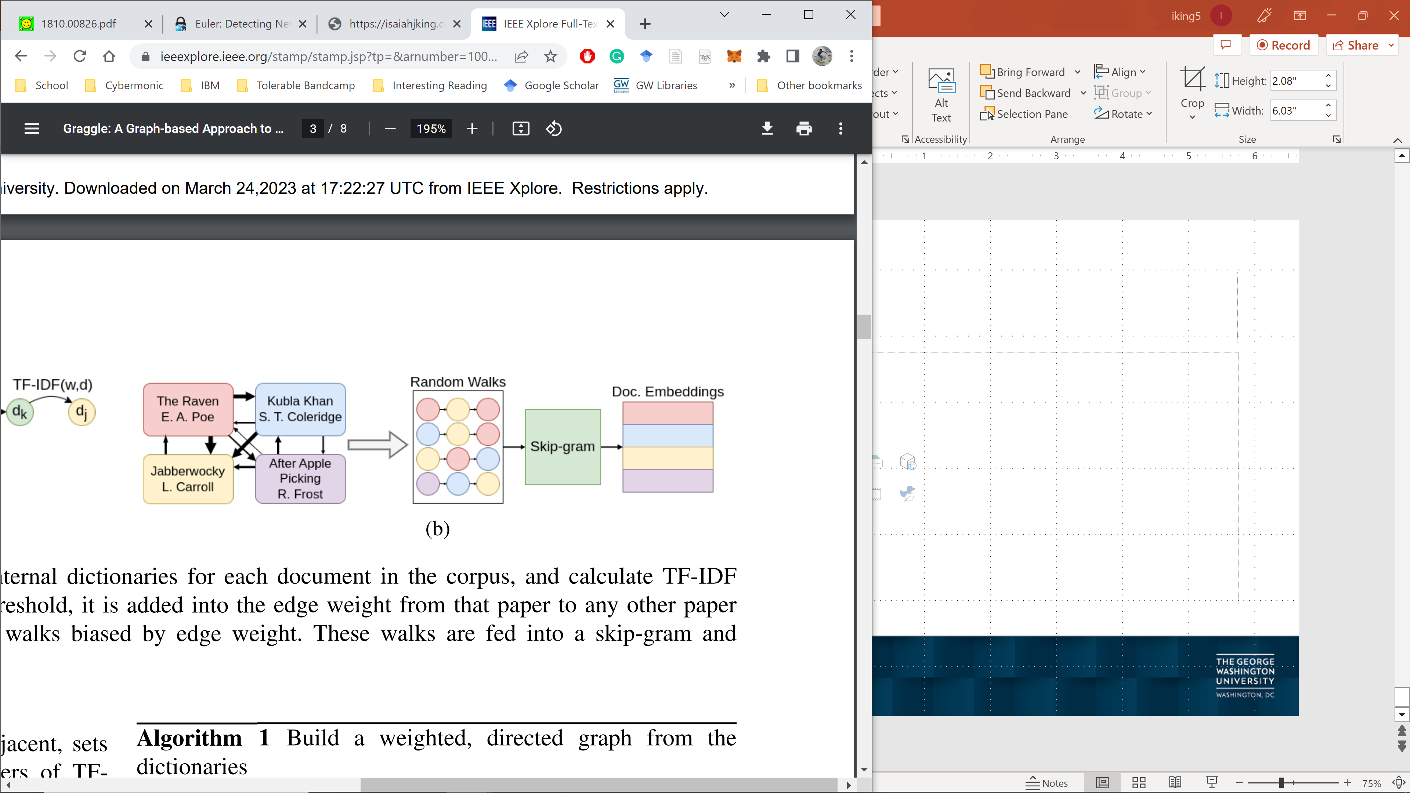
Solution: build graph of documents that share words

Slide 28
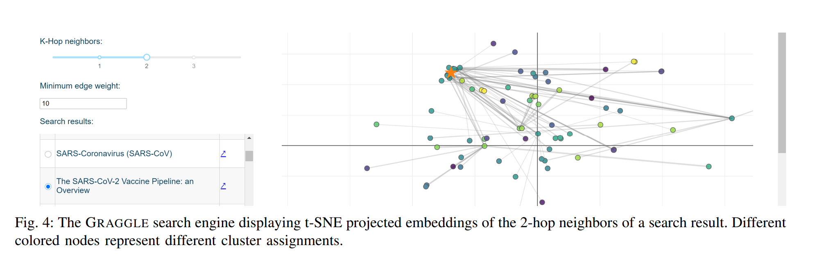
Applied to unlabled corpus of COVID-19 research papers

Slide 29
Your turn to try!
https://github.com/zazyzaya/CloudGNNIntro

